Slide 2
Input Output Devices
Access to I/O devices is different from access to memory devices (cache, ROM, RAM)
I/O devices are usually not semiconductor devices.
Need more than electronic decoding/switching
They are often bulky and have moving parts
So they can not be stored on board.
Most significantly I/O devices are slow
Speed mismatch between Processor and I/O devices
Fully synchronous I/O will heavily impair processor utilization

Slide 3
I/O Techniques
Polling:
pseudo-asynchronous
Processor inspects (multiple) devices in rotation
Even with several devices,
processor may still be forced to do useless work or wait or both.
Interrupts:
Processor initiates I/O by requesting an operation with the device.
May disconnect if response can’t be immediate, which is usually the case
When device is ready with a response it interrupts the processor.
Processor finishes I/O with the device.
Asynchronous
Data transfer between I/O device and memory still requires processor to execute instructions.

Slide 4
I/O Techniques
Direct Memory Access
Processor initiates I/O
DMA controller acts as an intermediary:
interacts with the device,
transfers data to/from memory as appropriate, and
interrupts processor to signal completion.
From the processor’s perspective DMA controller is yet another device
But one that works at semiconductor speeds
I/O Processor
More sophisticated version of DMA controller with
the ability to execute code: execute I/O routines, interact with the O/S etc.

Slide 5
I/O Performance
I/O may be a small component of a program
Why worry about I/O performance?
Speed-up and Amdahl’s Law
Say I/O is a fraction f of the total work-load.
And you improve the rest of the system by a factor of x
Then the effective speedup is:
T_{origin} / (f*T_{origin} + (1-f)*T_{origin}/x) = 1/(f+(1-f)/x)
Implications of Amdahl’s Law:
Example:
if 10% of time is spent in I/O and
rest of the system performance improves by a factor of 100
then the effective speedup is
1/(0.1 + 0.9/100) = 1/0.109 = 9.17 (approx.)
At the limit
Lt _{x→∞} (Speedup) = 1/(f + 0) = 1/f

Slide 6
I/O - Performance Parameters
I/O Rate
Number of I/O operations per unit time
Data Transfer Rate
Affects Time Taken for completion of a single I/O operation.
I/O Performance depends on various factors:
The specific I/O device
Processing Overhead
Architecture and Operating Systems Design
E.g. DMA performance, availability of buffer cache

Slide 7
What is a Bus ?
A bus is
a shared communication link between sub- systems of a computer and
an associated protocol for communication
Note: A protocol is a set of rules - often specified formally.
E.g.
Single Shared bus
Separate system bus and I/O bus
Memory
Data Lines
Processor
Control Lines
Address Lines
I/O
I/O

Slide 8
Why?
Why use a bus?
A bus defines “standardized communication” between components.
This facilitates Modular Design
Benefits of Modular Design:
vendor-neutrality, extensibility and scalability of structure

Slide 9
Bus Design
Basic Issues
Speed Mismatch between subsystems
Memory bus vs. I/O bus
Speed variation within I/O Devices
Performance Issues
High I/O rate requirements vs. High data transfer rate requirements
Scalability Issues
Length of the bus
Could cause clock (if synchronous) to be skewed
Number of devices on the bus (Bus Loading)
Limited by total current drawn

Slide 10
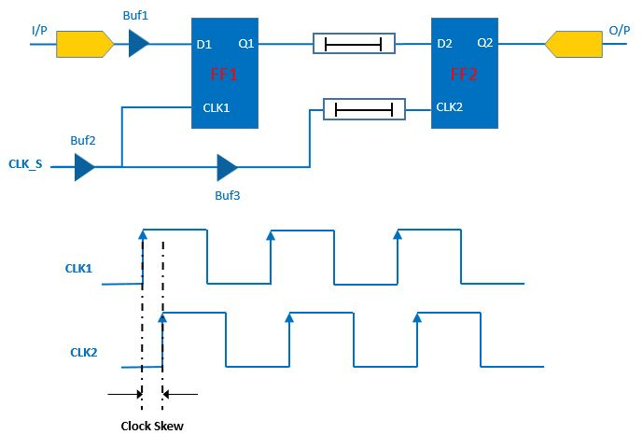
Clock skew
Clock skew is a phenomenon in synchronous digital circuit systems in which the same sourced clock signal arrives at different components at different times. The instantaneous difference between the readings of any two clocks is called their skew.

Slide 11
Memory Bus vs. I/O Bus
Memory bus
is short
Fewer devices
They are placed closer to the processor (same chip or board)
operates at a high speed
Memory devices are semiconductor devices
is speed-matched with RAM for better performance
I/O bus
is long
I/O devices are many
They occupy more space and
They are placed apart from the processor
has to handle different types of devices with varying latencies and data transfer rates

Slide 12
Signaling - Example
Read on a Synchronous bus
Clock
Address
Data
____
Read / Write

Slide 13
Bus Design
Design Tradeoff:
High Performance vs. Low Cost
Design Parameters
Synchronous vs. Asynchronous
Clocked operation gives high performance but is costly.
Parallel vs. Serial
Data Width
8 bits to 64 bits of data
Bus width
Separate address and data lines vs. multiplexed address/data lines
Transfer Size
Single word (i.e. one word at a time) or Multiword (a sequence of words in one exchange)
Bus masters
Single or Multiple ( arbitration required for multiple masters)

Slide 14
Synchronous vs. Asynchronous
Longer buses lead to skewed clock
Signals travel at a finite speed – arrive at different times at different parts of the circuit (or bus line)
(Maximum) Difference in arrival time is clock skew
So, synchronous operation is not good for longer buses
If speed variation among I/O devices is high then synchronous operation will slow things down
Cost of synchronization (required for asynchronous operation) is fixed per device.

Slide 15
Multiple Masters
Masters
CPU
DMA controllers or I/O processors
DMA controller
Ability to read/write from memory without involving CPU
External to CPU and therefore must be a bus master.
Once operation is done, DMA interrupts the CPU.
Multiple DMA controllers may be present in a system
E.g. Devices may come with DMA-enabled controllers
I/O Processors
I/O Processors execute I/O operations
Often they run programs (I/O routines) – fixed programs or programs downloaded by the OS

Slide 16
Bus Standards
CPU-Memory buses are often tied to specific (CPU) vendors
Sun, IBM, HP, Apple
I/O bus standards
RS-232 Serial Bus
PCI, IDE/ATA, SCSI parallel Bus
USB

Slide 17
Bus Standards - PCI
Peripheral Component Interconnect
Low cost, processor independent, Plug-n-play
Memory, I/O and configuration address spaces
4 bits part of the address identifies the address space
Configuration address space addresses a ROM placed in each device interface
Arbitrated
At a given time one device is the master (a.k.a. initiator) and the addressed device is the target
Synchronous, 33 or 66 MHz
Peak Bandwidth 533 MB/sec
32 or 64 bits wide

Slide 18
Bus Standards - SCSI
Small Computer System Interface
Asynchronous
Clock Rate (10, 20, 40, 80, or 160 MHz)
Data Width 8 (narrow) or 16 (wide)
Bandwidth 320MB/sec
Arbitrated
(Protocol will be discussed later)

Slide 19
Typical Configurations
See Following slides for typical Personal Computer / Workstation configurations and I/O buses.
Slide 20 (Generic diagram of classic PC bus configuration)
Slide 21 (A more specific diagram of the above)
Slide 22 (A typical modern PC bus configuration)

Slide 20
CPU Memory Bus
Cache
Bus Adapter
Bus Adapter
Main Memory
CPU
AGP Bus
PCI Bus
I/O Controller
Bus Adapter
I/O Controller
I/O Bus
Network
Graphical
Output
I/O Controller
I/O Controller
Fig. from Patterson & Hennessey
Disk
Disk
CD

Slide 21
CPU Memory Bus
Cache
Bus Adapter
Main Memory
CPU
PCI Bus
USB Controller
SCSI Controller
Ethernet Interface
Keyboard
SCSI Bus
Disk Controller
CD-ROM Controller
Fig. from Hamacher et. al.
Disk
Disk
CD

Slide 22
Front Side Bus
Cache
Main Memory
North Bridge
Graphics
Accelerator
Monitor
CPU
PCI Bus
South Bridge
SCSI
HBA
USB
Ethernet
Interface
Interrupt Controller
PCI Slots
IRQs
INTR
SCSI Bus
ISA Bus
Disk
Controller
CD-ROM
Controller
Fig. adapted from PCI Sys. Arch. by MindShare
BIOS
I/O Controller
COM1
COM2
Disk
CD
Keyboard
Mouse

